Slide 1



Employee Attrition Prediction
Presented by
Aindrila Roy
Shinjini Banerjee
Syed Farhan Ali
Samik Ranjan Das
Avik Ranjan Das
Arghya Hazra
Major Project | 2024
KIIT University

Slide 2
ACKNOWLEDGEMENT
We are grateful to Prof. Kumar Devadutta for his expert guidance and continuous encouragement to help us in building this project.
We would also like to thank our peers for constantly supporting us throughout the process of building this valuable project.
We would like to thank the people who have conducted research on this topic because their insights were very useful in paving a path towards building this project.

Slide 3
ABSTRACT
Attrition refers to the rate at which employees leave an organization over a certain period. It is a common phenomenon in most organizations, and some factors that cause this are :
Job dissatisfaction
Lack of growth opportunities
Poor working conditions
Inadequate compensation.

Slide 4

INTRODUCTION
Employee attrition can be a significant challenge for organizations, and this project aims to help companies overcome that using machine learning techniques like :
Data Preprocessing
Feature Selection
Model Training
Model Optimization

Slide 5
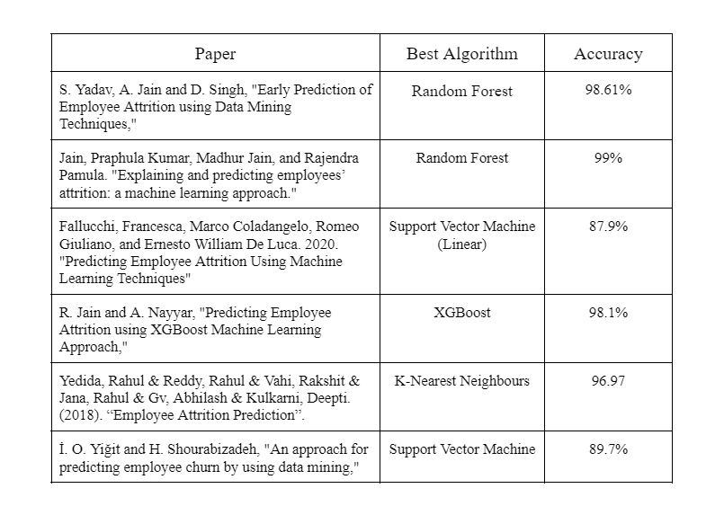
RELATED WORK
Employee count turnover is an issue often overlooked when calculating annual profit earned by a company. It refers to the rate employees leave an organization over a given period. The loss of a single hardworking employee causes at least twice the employee's annual salary. Numerous studies found that employees who quit the organisation do that because of job satisfaction. The results of each study are given in the table.

Slide 6
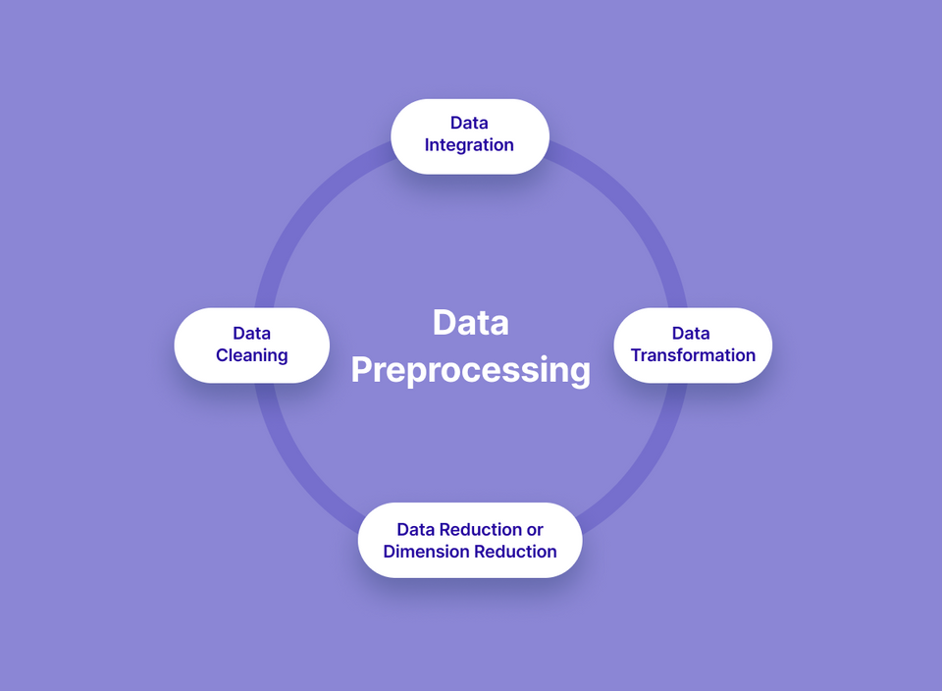
METHODOLOGY
Data preprocessing refers to the process of
cleaning, transforming, and preparing raw data in a format that is suitable for analysis. It involves several techniques to make the data more useful and informative, such as data cleaning, data integration, data transformation, data reduction, and data normalization.

Slide 7
DATA CLEANING
Data cleaning is the process of detecting, correcting, and removing errors, inconsistencies, and inaccuracies from raw data. The purpose of data cleaning is to improve the quality of data, ensuring that it is accurate, complete, and consistent.
Data cleaning involves several techniques such as removing duplicates, handling missing values, correcting inconsistencies, and dealing with outliers.
There follows other techniques after data cleaning which includes data transformation,data integration, data reduction, and data normalization.

Slide 8

FEATURE SELECTION
Used to reduce the dimensionality of a dataset
Compute the correlation coefficient between each pair of features in the dataset.
Redundant features have a high correlation coefficient and are eliminated
Helps increase the accuracy and efficiency of a machine learning model
CORRELATION MATRIX
A statistical technique used for feature identification
Measures the difference between the observed frequency and the expected frequency of a particular feature in each class of the target variable.
Features with high chi-square values are important for prediction
Importance of the features is ranked based on the chi-square statistic
CHI-SQUARE
METHOD

Slide 9
MODEL TRAINING
KNN
Logistic
Regression
Decision Trees
Random Forest
MLP
XGBoost
Non-parametric
algorithm
Used for regression and classification
New data points are classified based on labels identified
These labels are gathered from the k-nearest neighbors of each point
Tree based machine learning algorithm
Used for regression and classification
Recursively split the data to build the model
Model split based on values of predictor variables
Ensemble machine learning algorithm
Used for regression and classification
Multiple decision trees are trained on randomly sampled subsets of the data
Random subsets used for accurate
predictions
A type of Artificial Neural Network(ANN)
Consists of multiple layers of inter-connected nodes
Used for supervised learning tasks
ANN inspired by biological neural networks
ANN used in NLP and prediction
Statistical algorithm used for binary classification
Used to predict probability of a binary outcome
This is done using one or more predictor variables
Scalable and efficient gradient boosting algorithm
Used for regression, classification and ranking tasks
Known for speed, performance and ability to handle large datasets

Slide 10
HYPERPARAMETER TUNING
Hyperparameters are parameters that are not learned from the data, but rather set prior to training the model, aka, model fitting.
Hyperparameter tuning is trying out different combinations of hyperparameters and evaluating the model's performance on a validation set to find the best set of hyperparameters that give the best results.

Slide 11
MODEL FITTING
Model fitting involves selecting an appropriate model architecture and optimizing its parameters or weights using an algorithm that minimizes a loss function.
Cross-validation involves dividing the data into multiple folds, training the model on a subset of the data, and evaluating its performance on the remaining fold. This process is repeated for each fold, and the average performance across all folds is used to estimate the performance of the model.

Slide 12
CONCLUSION
This project demonstrates the importance of analyzing data and leveraging machine learning to gain insights into employee attrition and inform organizational decision-making.
These results can be used by HR to counsel the valuable employees who are facing some issues in the company and help them out.
This can be done by giving incentives, reducing the workload or just a token of appreciation.
This study can change the profitability of a business to a huge extent.

Slide 13
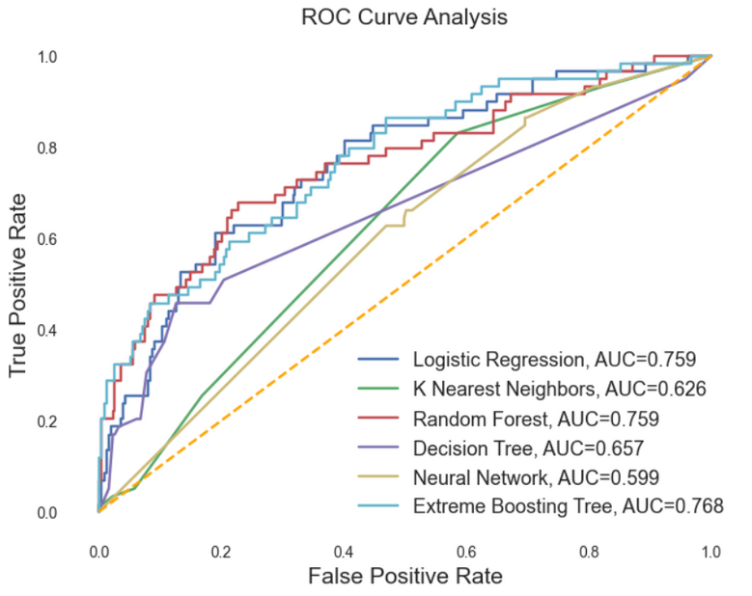
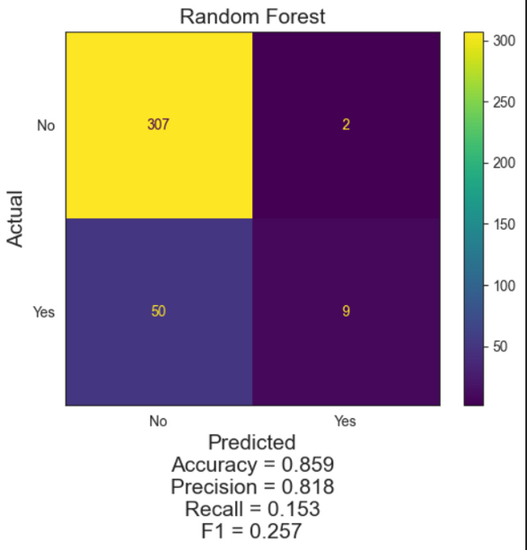
RESULT
When the correlation matrix was used for feature selection, we trained six models and the model that gave the best performance was Random Forest,
with an accuracy of 87%.
When we used chi-square distribution for feature selection, we trained 4 models and the model that gave the best performance here was also Random Forest, with an accuracy of 85.9%, as shown in the figure.
The ROC-AUC curve is also shown below.

Slide 14
RESULT ANALYSIS METHODS
A confusion matrix is created to evaluate the performance of all the models. It summarizes the number of correct and incorrect predictions made by the model on a set of data for which the true values are known.
CONFUSION MATRIX
A Receiver Operating Characteristic (ROC) curve is a graphical plot that illustrates the performance of a binary classification model at different classification thresholds.
ROC AUC CURVE

Slide 15
THANK YOU

